Slide 1

Students Performance Data Set
By:
Sheetal Kumar
kumarisheetal394@gmail.com
Nov 19 Cohort

Slide 2
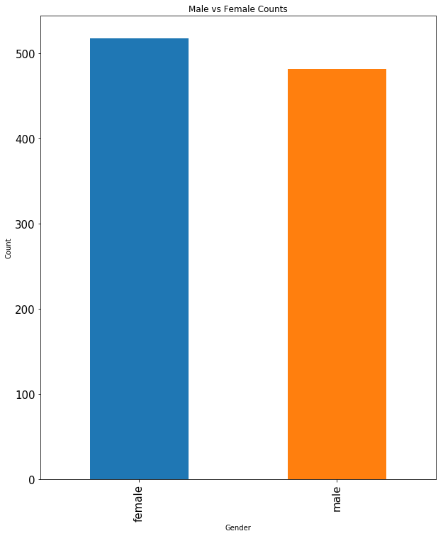
Gender
Bar Chart represents Male vs Female counts.

Slide 3
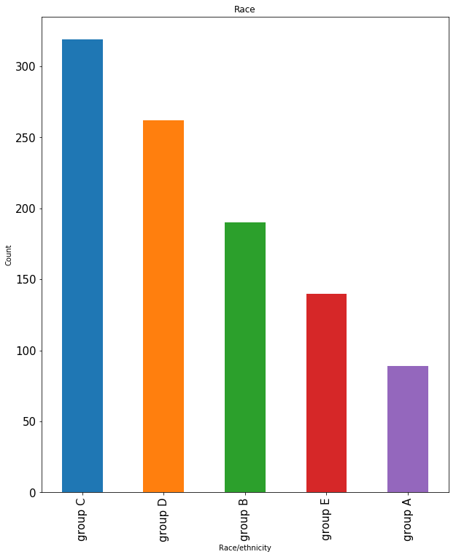
Group
Plot showing the number of people in each Group.

Slide 4
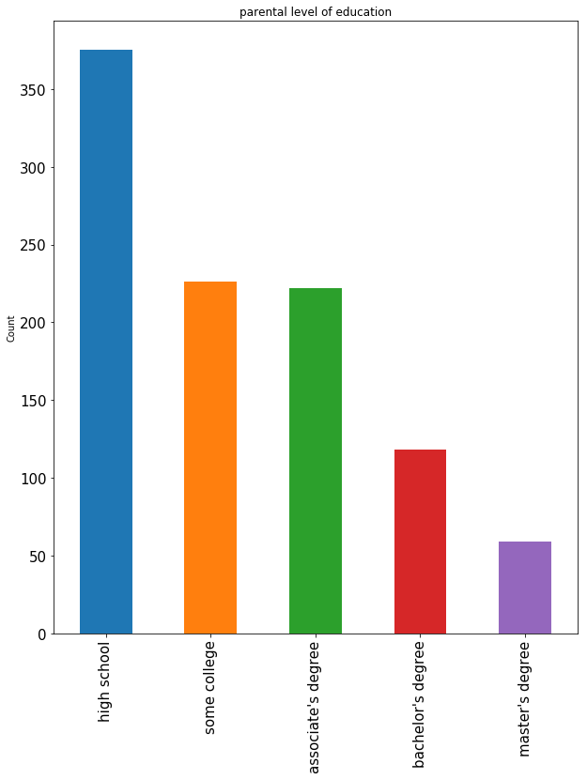
Parental Level of Education
Bar graph showing Parents highest Qualification. Parents whose high school qualification is highest.

Slide 5
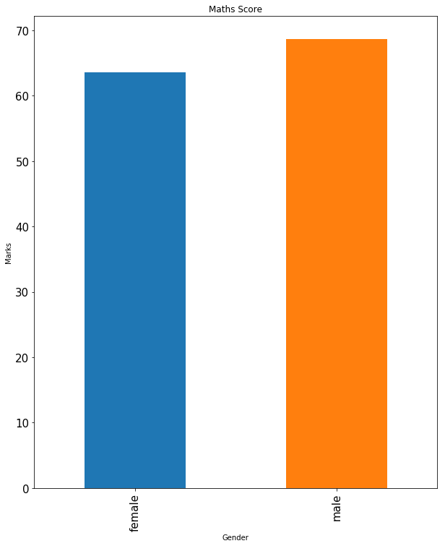
Math's Score - Gender
Male got more marks in math's as compared to female.

Slide 6
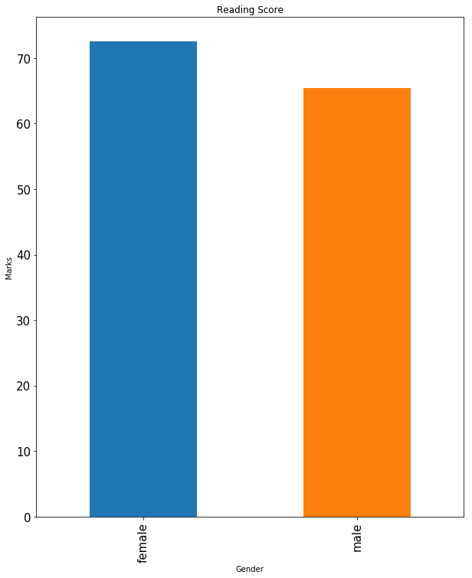
Reading Score
Female got high marks in Reading.

Slide 7
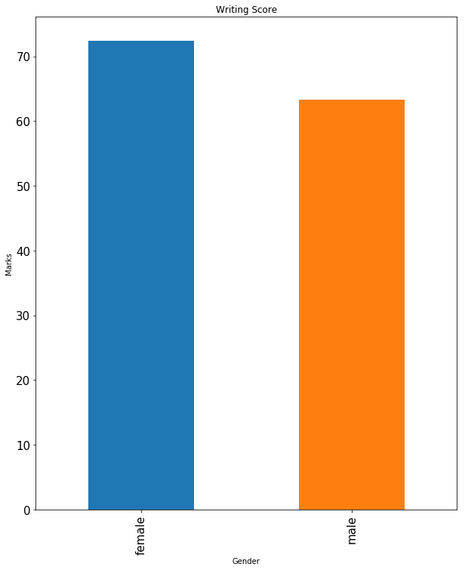
Writing Score
In writing also female scored high.

Slide 8
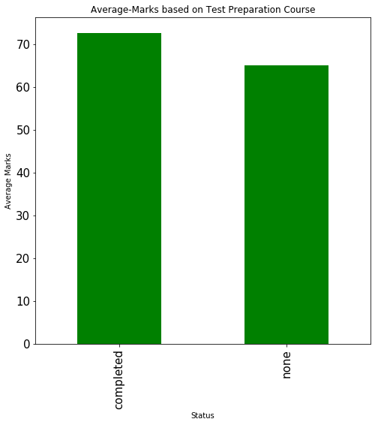
Average-Marks based on Test Preparation Course
Students who completed test preparation showed a visible difference.

Slide 9
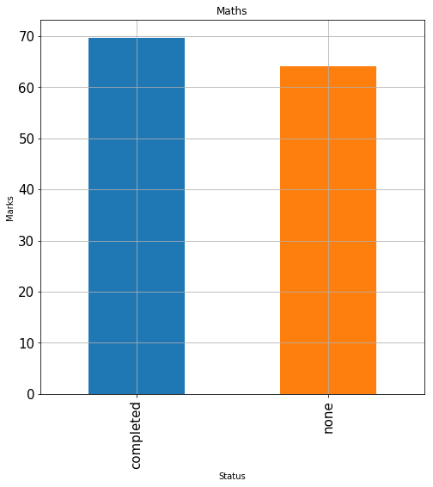
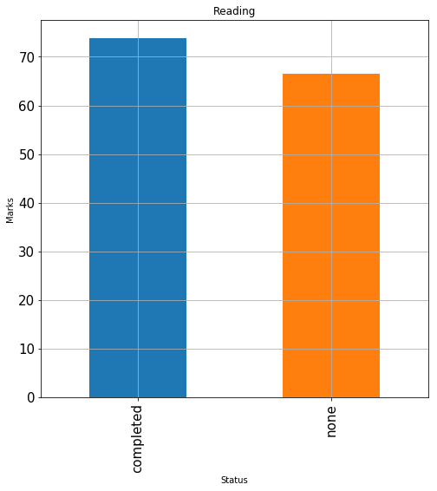
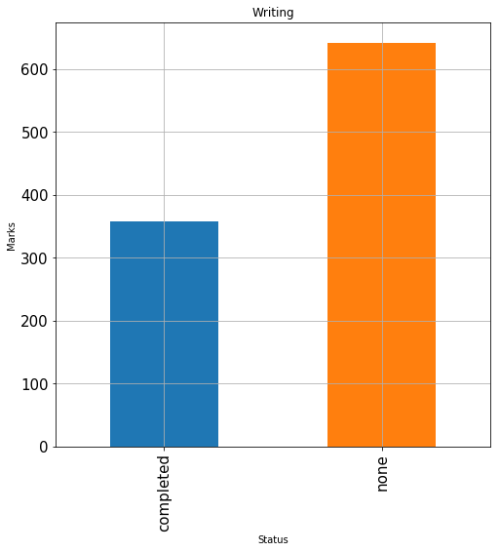
Subject Analysis
Respective subjects score based on Test preparation.

Slide 10
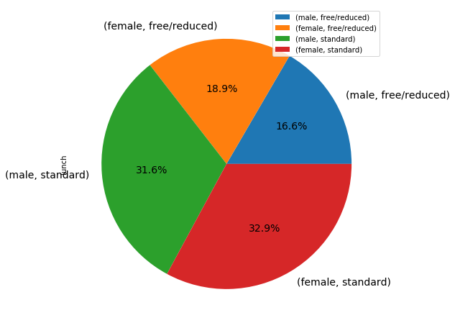
Gender vice Lunch
32.9% females prefer standard lunch & male with 16.6% Free/reduced lunch

Slide 11
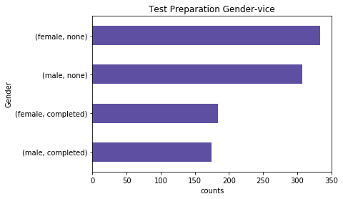
Test Preparation Gender-vice
Completion of test preparation course for both male and female is less.

Slide 12
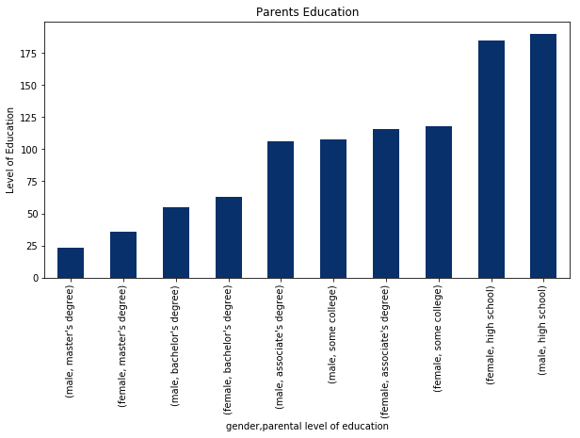
Parents Education
Graph show the qualification of Parents (Gender vice)

Slide 13
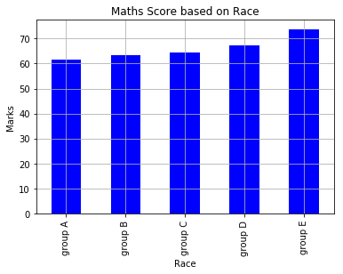
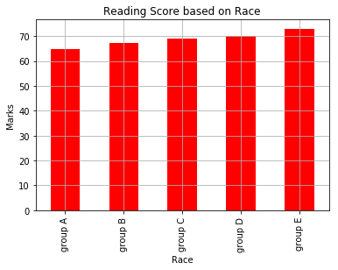
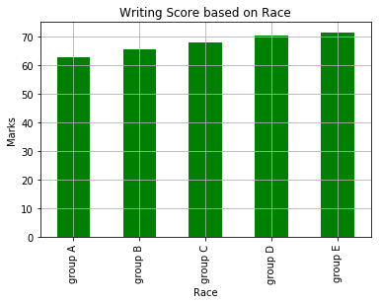
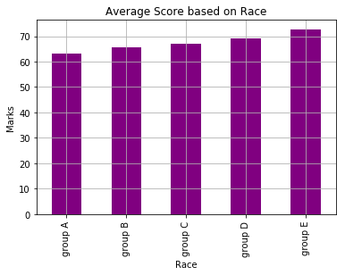
Marks Scored based on Race
Comparing the below bar graphs, Group E performed significantly good than other groups & Group A was least performer.

Slide 14
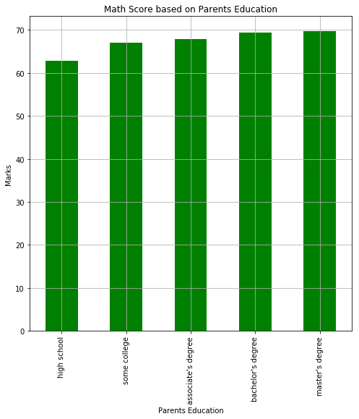
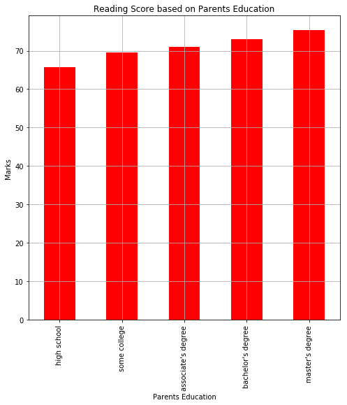
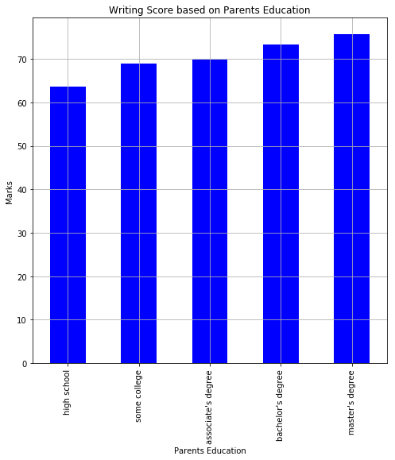
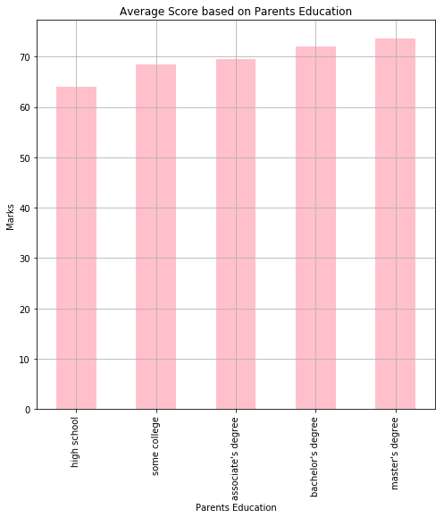
Marks scored based on Parents Education
The present bar graph shows, Students scores based on the level of Parents Qualification.

Slide 15
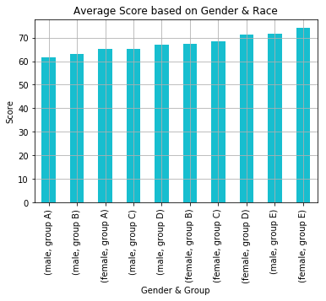
Average Score based on Gender & Race
Group E (Female Scores) clearly outperform rest of the Groups.

Slide 16
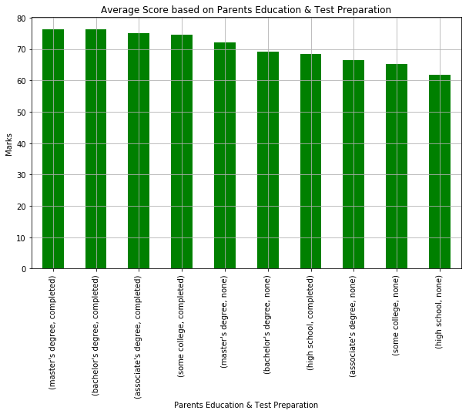
Average Score based on Parents Education & Test Preparation
Bar graph clearly shows, students performed well, whose parents qualification is masters degree and who has
completed test preparation.

Slide 17
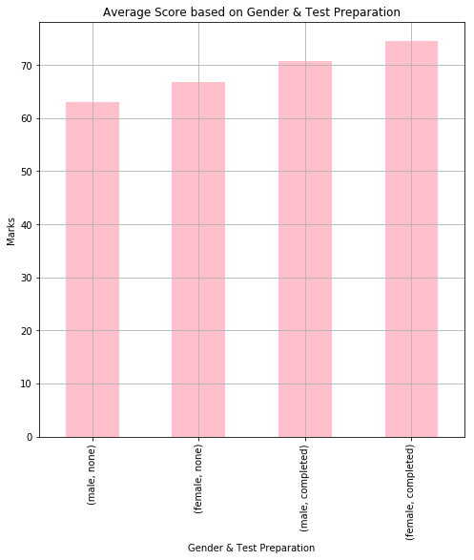
Average Score based on Gender & Test Preparation
Gender/Test-Preparation Scores

Slide 18
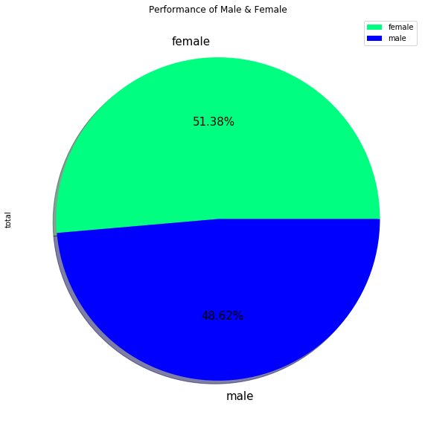
Performance of Male & Female
Pie chart shows the average marks considering all 3 subjects in which female marginally achieved more marks than male.

Slide 19
Thank You

